Slide 1
A Novel Approach to Predict Blood Group using Fingerprint Map Reading

Slide 2
Abstract
This study presents a novel machine learning-based approach to predict an individual's blood group using fingerprint image analysis. The system utilizes thermal spectroscopic photoplethysmographic (PPG) sensor images to capture fingerprint patterns. These images are processed to extract Gabor features, which serve as input signals for machine learning models. The extracted data is used to train a convolutional neural network (CNN), achieving high performance with an accuracy of 97% on the test dataset. The trained model is capable of classifying various blood groups, including A+, A−, B+, B−, AB+, AB−, O+, and O−.

Slide 3
Introduction
Blood group identification is a vital component in the fields of healthcare, forensic science, and genetics. Traditional blood typing methods rely on serological tests that require blood samples, reagents, and time-consuming laboratory procedures. However, in emergency scenarios or remote areas where laboratory resources are limited, a fast, non-invasive, and automated method for predicting an individual's blood group could significantly enhance medical response and diagnostic capabilities.
In this project, we propose a novel, contactless approach for predicting blood groups using fingerprint map reading combined with Thermal Spectroscopic Photoplethysmographic (PPG) sensors. These thermal fingerprint images are processed to extract Gabor filter-based signal features, which serve as input to a machine learning (ML) model trained to classify blood group types.

Slide 4
Literature servvey
Biometric Correlation with Physiological Traits Previous studies have explored correlations between biometric traits such as fingerprints and physiological attributes (e.g., gender, age, and blood group). For example, research has shown patterns in dermatoglyphics (ridge patterns in fingerprints) can vary across different blood groups, suggesting predictive potential.
Use of Gabor Filters in Image Processing Gabor filters are widely used in feature extraction for biometric images due to their ability to capture spatial frequency and orientation information. These filters are particularly effective in analyzing texture patterns in fingerprint images, which enhances the discriminatory power for classification tasks.

Slide 5
Existing System
In the current healthcare and biometric systems, blood group identification typically relies on conventional laboratory-based tests such as blood sample analysis through serological methods. These tests require physical collection of blood, trained personnel, and laboratory infrastructure, which can be time-consuming, invasive, and sometimes inaccessible in remote or emergency scenarios. Moreover, there is no existing system that attempts to non-invasively predict a person’s blood group solely from biometric data such as fingerprints. While fingerprint biometrics have been widely used for identification and authentication purposes, their potential in medical diagnostics—especially in blood group prediction—has remained largely unexplored.

Slide 6
Drawbacks
• Invasive Blood Testing Traditional blood group identification methods require invasive procedures like drawing blood, which may be uncomfortable, painful, or risky for certain individuals (e.g., infants, elderly, or those with needle phobia).
• Time-Consuming Laboratory Analysis Existing methods often require sample preparation, transportation to laboratories, and testing time, which delays result availability, especially in emergency situations.

Slide 7
Proposed System
The proposed system introduces a novel, non-invasive method for predicting an individual’s blood group using fingerprint map reading derived from thermal spectroscopic Photoplethysmographic (PPG) sensors. In this approach, fingerprint images captured via specialized sensors are processed to extract Gabor signal features, which are then fed into a Convolutional Neural Network (CNN) machine learning model. This trained model is capable of classifying the fingerprint image into the corresponding blood group category with high accuracy. The application includes essential modules such as User Login, Train ML Algorithm, and Prediction. Users can log into the system, train the ML model with thermal fingerprint data, view performance metrics (accuracy, precision, recall, F1-score), and predict blood group for new input images.

Slide 8
Advantages
• Non-Invasive Blood Group Detection The system uses fingerprint images captured via Thermal Spectroscopic Photoplethysmographic (PPG) sensors, making the blood group prediction process completely non-invasive—no need for blood samples.
• High Prediction Accuracy The Machine Learning model, specifically a Convolutional Neural Network (CNN), achieved an accuracy of 97%, as shown in the training result screenshots. This indicates strong model performance and reliable predictions.

Slide 9
HARDWARE REQUIREMENTS:
• System : Pentium IV 2.4 GHz.
• Hard Disk : 40 GB.
• Ram : 512 Mb.

Slide 10
SOFTWARE REQUIREMENTS:
• Operating system : Windows.
• Coding Language : python.

Slide 11
Modules
1. Environment Setup
Python Version: 3.7.2
Libraries: All required packages are listed in requirements.txt.
Execution: Start the server by running the run.bat file. This launches a local Python web server.
2. Application Modules
a. User Login
b. Train ML Algorithm
c. Prediction

Slide 12
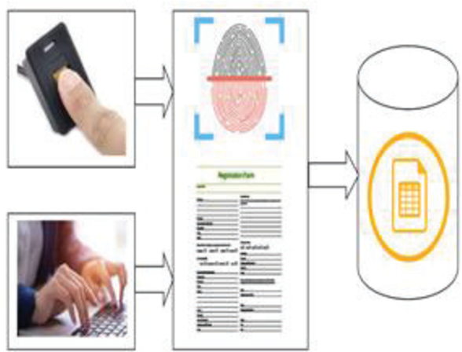
System Architecture:

Slide 13
UML
Class Diagram:

Slide 14
Use case Diagram:

Slide 15
Sequence Diagram:

Slide 16
Collaboration Diagram:

Slide 17
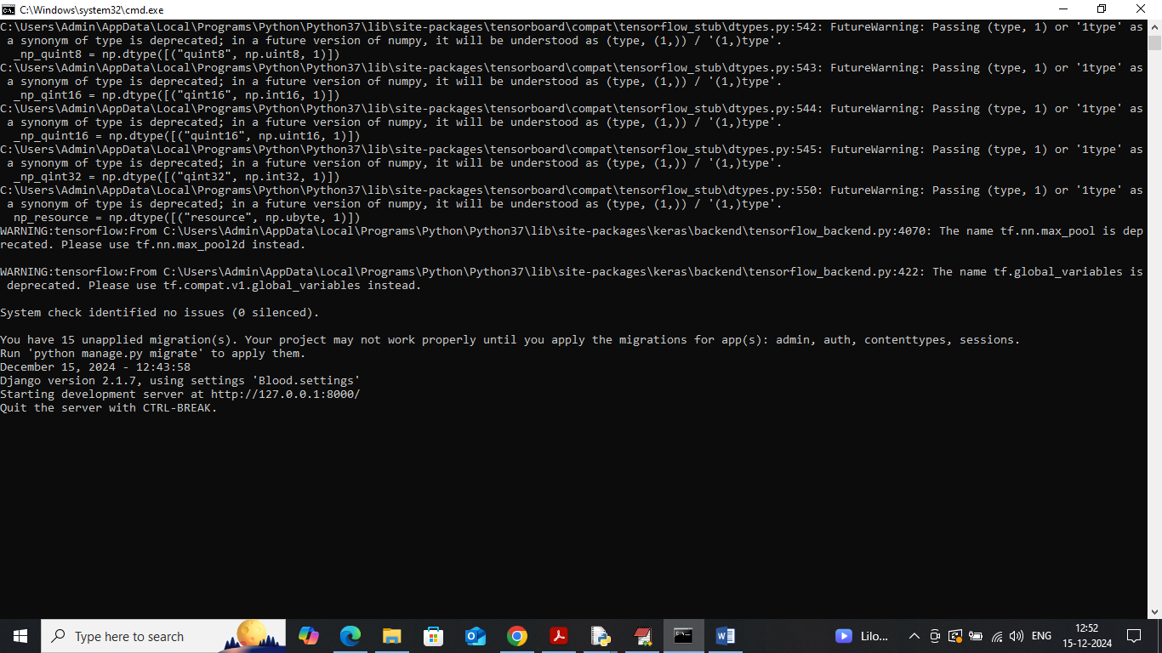

Slide 18
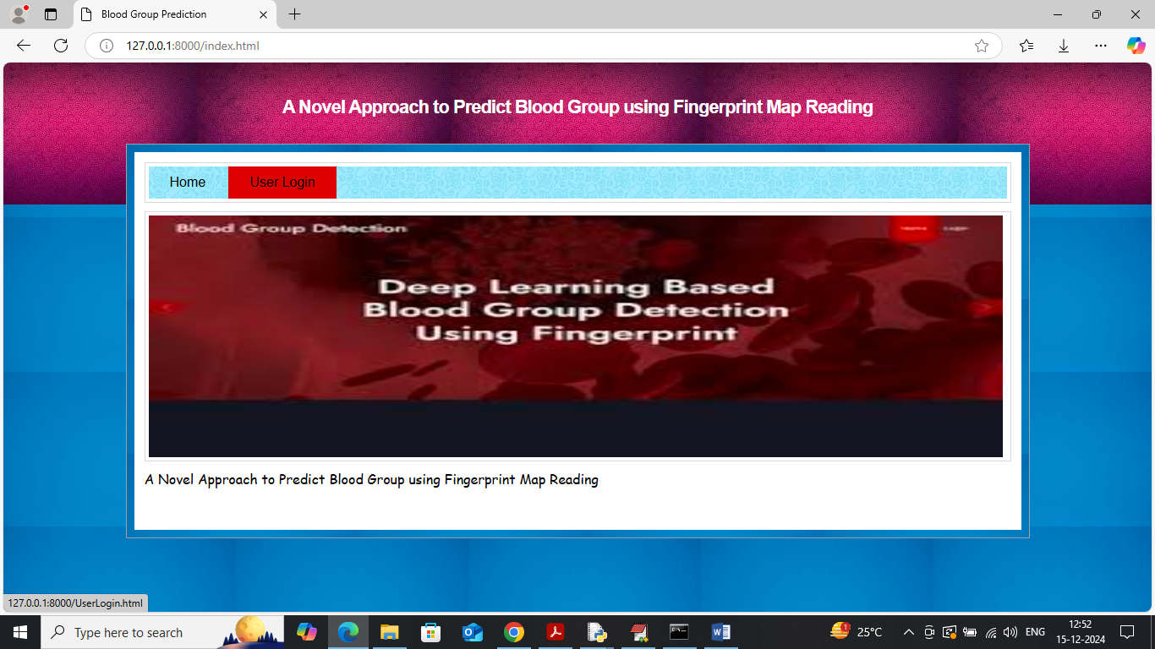

Slide 19
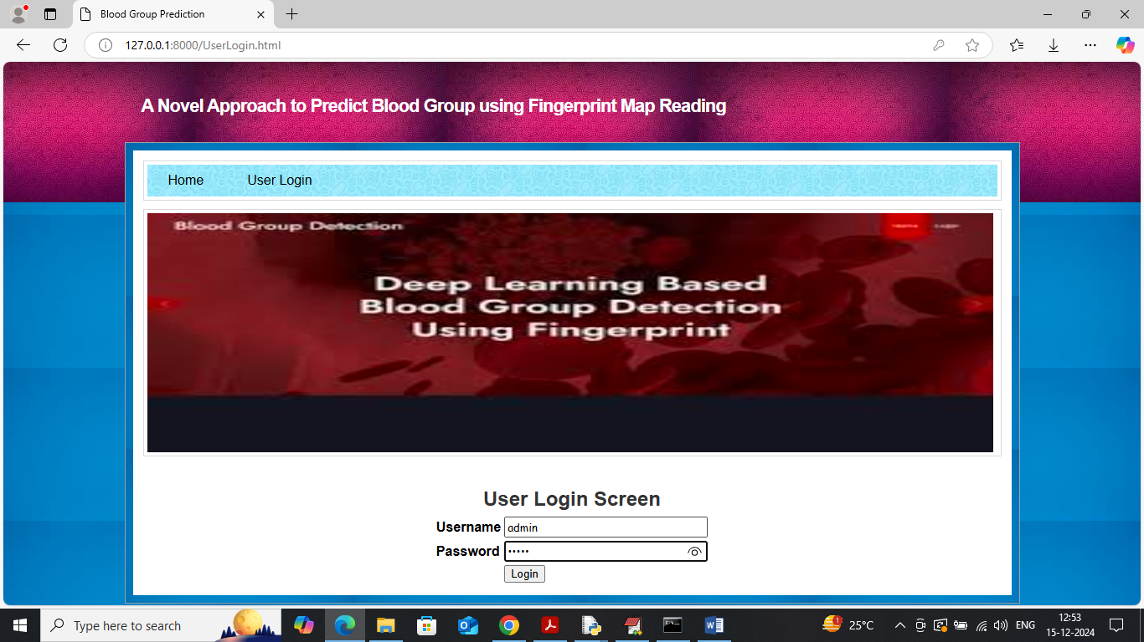

Slide 20
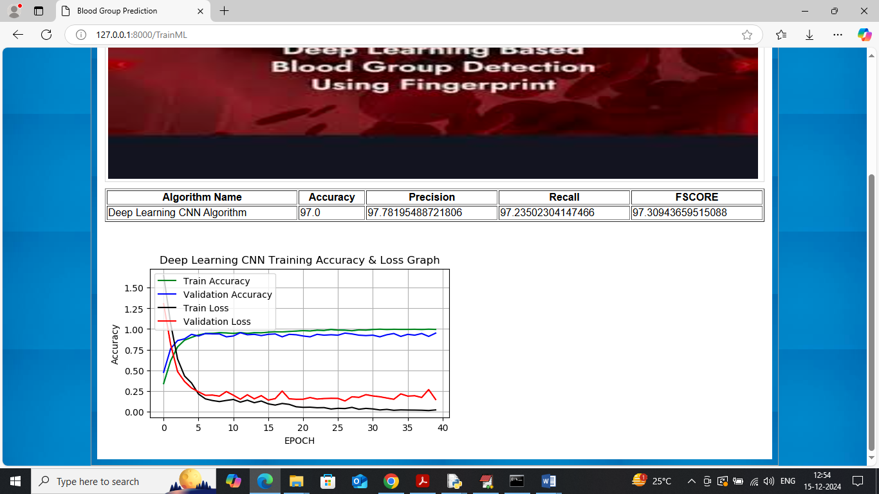

Slide 21
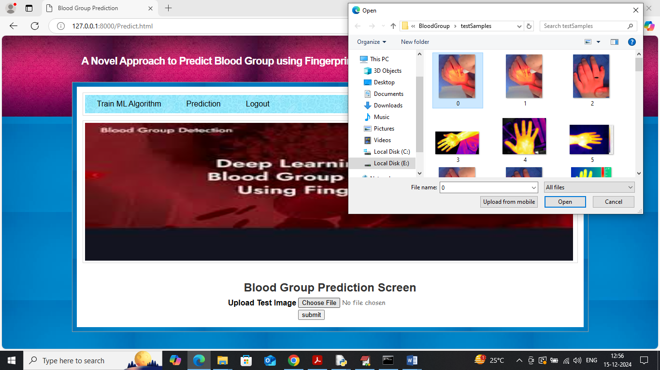

Slide 22
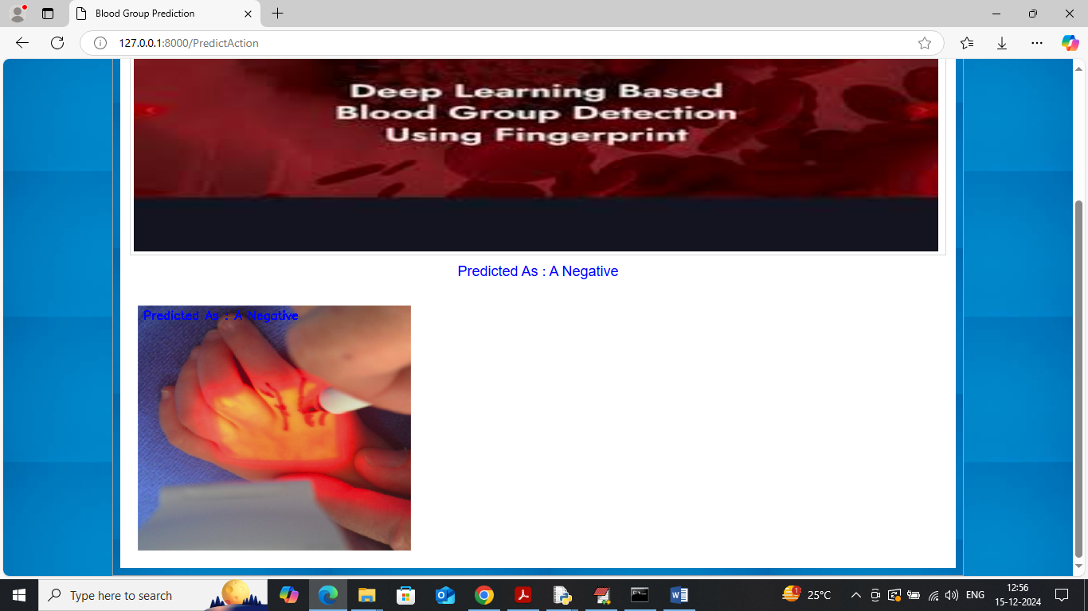

Slide 23
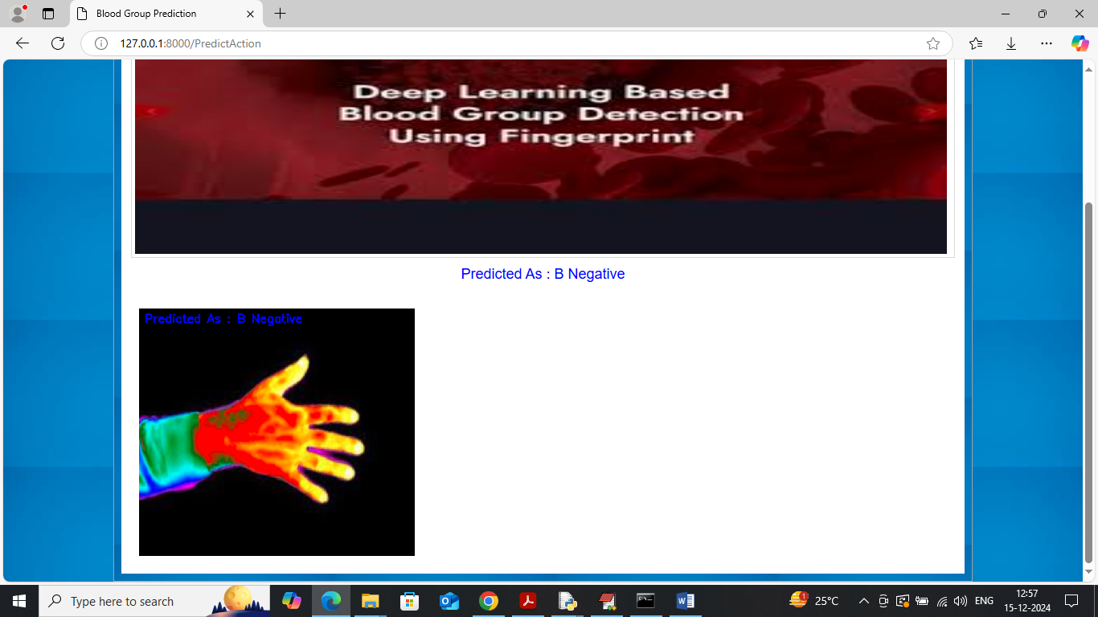

Slide 24
Conclusion
This study demonstrates a novel and innovative approach to predicting an individual's blood group using fingerprint images captured via a Thermal Spectroscopic Photoplethysmographic (PPG) sensor. By extracting Gabor features from these fingerprint images and training a Convolutional Neural Network (CNN)-based machine learning model, the system achieved an impressive prediction accuracy of 97%. The model consistently performed well across various evaluation metrics including precision, recall, and F1-score, as visualized through accuracy-loss graphs. The system provides a practical, non-invasive, and efficient method for blood group classification, which could prove valuable in medical, forensic, and biometric identification scenarios. Through an intuitive interface and seamless image processing pipeline, this application enables users to accurately predict blood groups from thermal fingerprint scans.

Slide 25
Future work
While the results are promising, several opportunities exist to further enhance and expand the proposed system. Future work could focus on increasing the dataset size and diversity to improve the generalization of the model, particularly for rare blood types. Integrating other biometric features such as palm prints or retinal scans may also help in improving prediction reliability. Additionally, exploring deep learning architectures beyond CNN—such as Transformers or hybrid models—could offer performance gains. Real-time processing capabilities and cross-platform deployment (e.g., mobile or embedded systems) could further broaden the application’s utility. Finally, collaboration with healthcare providers could facilitate real-world testing, validation, and potential regulatory approvals for clinical or emergency use.

Slide 26
Reference
• Jain, A. K., Ross, A., & Prabhakar, S. (2004). An introduction to biometric recognition. IEEE Transactions on Circuits and Systems for Video Technology, 14(1), 4–20.
• Maltoni, D., Maio, D., Jain, A. K., & Prabhakar, S. (2009). Handbook of Fingerprint Recognition. Springer Science & Business Media.
• Dey, S., Ghosh, A., & Bhattacharya, U. (2015). Fingerprint classification using a deep learning approach. In Proceedings of the International Conference on Pattern Recognition (ICPR).
• Peterson, L. E. (2009). K-nearest neighbor. Scholarpedia, 4(2), 1883.

Slide 27
THANK YOU

